Slide 1


Research Poster Creation and Presentation
John Starbuck

Slide 2
My Background
Biological Anthropology, Ph.D. (Penn State, 2012)
Anthropology, M.A. (Penn State, 2009)
Anthropology, B.A. (IUPUI, 2005)
Currently: Post-doctoral researcher IUSD 3D ICCC
2004-2005, IUPUI McNair Scholar
Authored, co-authored, and/or presented 35 conference presentations over last 9 years
  Many were poster presentations

Slide 3

What is a Poster Presentation?
Or, what does it mean for you if you have to do a poster presentation?
You create a poster with information about your research
  Your mentor will help and guide you
Hang poster up at a conference
Present the poster to people in attendance.
My
Research
Y
O
U

Slide 4
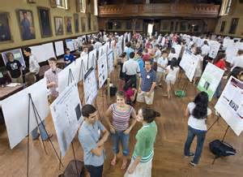
Poster Session
Research posters typically presented at poster sessions
  Common in scientific, medical conferences
    # of people in attendance varies

Slide 5
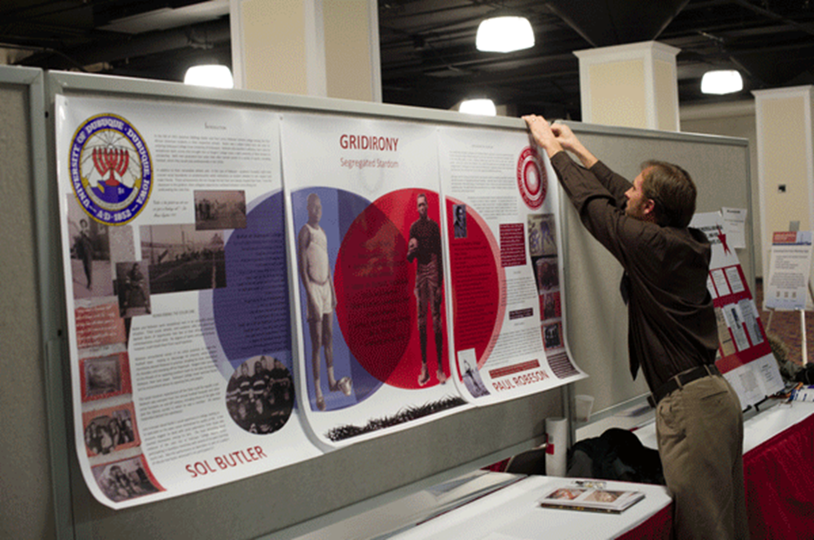
Poster Session
You hang or attach your poster to poster board on specific day/time
  Depends on conference guidelines
  Usually push pins provided, not always

Slide 6
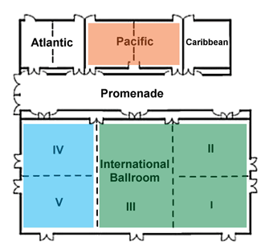
Poster Session
Typically a separate room or area designated for poster session
  Larger sessions may be divided into sections by topic, discipline, time/date
Anthropology
Good idea to check out
location beforehand
Engineering
Biology

Slide 7
Poster Presentation
Look up conference details to determine when and where to present poster
  Find online or in check-in materials
Five minutes early is “on time”
  May take several minutes to find board and hang poster
Dress business or business casual
  Wear name tag
Lots of people crammed into tiny space = hot
  Bring water

Slide 8
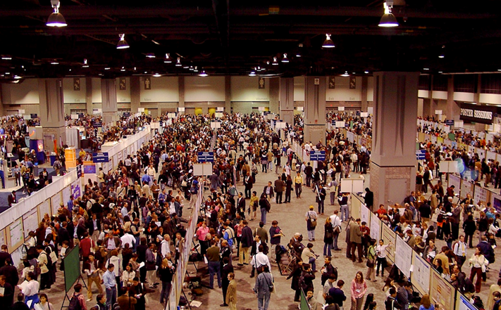

Slide 9
Poster Defense
What is a poster defense?
One or more researchers present poster
  Usually one person
Smile, be inviting
Explain content and answer questions from colleagues passing by
Presentation time varies
  One long stretch
  Or broken up into multiple smaller defenses throughout day

Slide 10
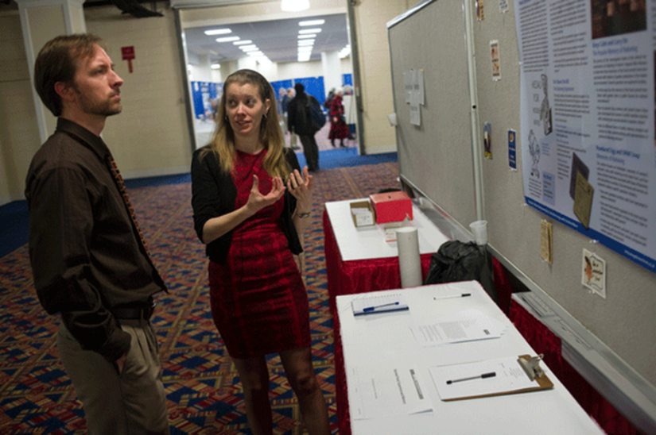
Poster Defense
People in attendance may stop by and look at your poster
  Greet them and offer to explain your research
    Some will let you walk them through the poster
      Be able to do this in 5-6 minutes
      Practice, practice, practice…
    Others will ask you to let them read through it first and then ask your questions

Slide 11


Poster Defense
Be prepared to answer questions about your research
  Why are you doing this? Why does it matter?
Business cards
Sample abstracts
Sample
abstract
or
business
cards
for
viewers
to take
Take me!

Slide 12
Questions Poster Should Answer
1. What is my poster presentation about?
2. Why am I conducting this research? Why does it matter?
3. What materials and methods did I use?
4. What are my results?
5. What conclusions did I make?
6. What are my recommendations or future directions based on this research?

Slide 13
The Parts of a Scientific Poster
Logo?
Title and Authors
Logo?
Materials
and methods
Results
(more figures?)
Abstract?
Conclusions
Introduction
Figures
References
This is a “Landscape” Layout

Slide 14
The Parts of a Scientific Poster
Logo?
Title and Authors
Logo?
Abstract?
Figures
Results
(more figures?)
Introduction
Conclusions
Materials
and methods
References
This is a “portrait” layout

Slide 15
Poster Content
Posters typically flow left to right
Or up to down

Slide 16
The Parts of a Scientific Poster
Format and layout varies by discipline and conference
  Posters may be square-shaped, landscape, portrait
  You may need different sections?
    Literature review
    Current status of research
    Future plans
    Funding, etc.
  Check with mentor to determine what is normal for your discipline and adhere to conference requirements

Slide 17
The Parts of a Scientific Poster
Title
  Well-thought out to attract viewers
  Concise, no more than two lines
  Bad Example: An Analysis of Developmental Instability as Measured by Fluctuating Asymmetry of the Soft-Tissue Facial Features of an Aneuploid Population whose Morphogenesis is affected by Trisomy 21 and Gene-Dosage Imbalance
  Better Example: Trisomy 21 and Facial Asymmetry
Huh?

Slide 18
The Parts of a Scientific Poster
Abstract
  Usually submitted beforehand for approval
  Often made available in a meeting or conference catalogue (online or in print)
  Short and concise
  Not required for all conferences/posters
    Check guidelines
  May have separate sections or be a single paragraph

Slide 19
The Parts of a Scientific Poster
Abstract Sections
  Introduction
    1-2 sentences
  Materials and Methods
    1-2 sentences
  Results
    1-3 sentences
  Conclusion(s)
  1-2 sentences, preferably 1
  May be additional sections depending on conference

Slide 20
The Parts of a Scientific Poster
Introduction
  1-2 short paragraphs
  Briefly introduce research background
  Introduce research question and hypothesis
I typically use 1 paragraph for introduction and 1 paragraph describing purpose of research

Slide 21
The Parts of a Scientific Poster
Materials and Methods
  Describe materials used and methods applied (including statistics and significance cutoffs)
  Include relevant images, charts, graphs to help viewer understand your project
  Explain why you chose your methods
    If explanation is long, may be better to leave off poster and explain in person
  Generally 2 paragraphs

Slide 22
The Parts of a Scientific Poster
Results
  Text with summary of results
  Figures and tables
    Label clearly and with caption
    Use figures and tables that look good to attract attention
    Sometimes caption text is only text in this section
  Discuss relationship between results and research question
More figures, less text and tables

Slide 23
The Parts of a Scientific Poster
Conclusions
  Briefly review research question, results, and your conclusions
    Bullet points acceptable/preferred
  Discuss why your results are interesting or significant
    Relate to other research when possible
    What are the broader implications or applications?
    Future steps?

Slide 24
The Parts of a Scientific Poster
References
  List references
  Break into columns if needed
  It is common to use smaller font here to make everything fit
  Some conferences don’t require this section

Slide 25
The Parts of a Scientific Poster
Acknowledgements
  People who helped you with your research
    Lab members, mentors, etc.
  Funding sources
    Names, grant numbers
  Section should be short and concise
    40-50 words
  Sometimes logos can be used instead of words

Slide 26


Shameless Plug?… or Logo Examples
If already on poster, redundant
to write out again

Slide 27
Planning Poster Content
Do not overload poster with text
  Summarize your info briefly and concisely
Your poster should be
  Visually interesting, attractive
  Easy to scan over quickly
  Where possible, use chart or graph instead of “wordy” table

Slide 28
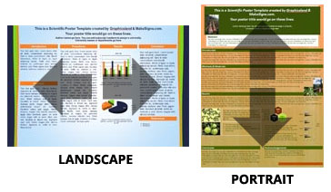
Planning Poster Content
The size of the poster varies by conference
  Look up conference guidelines beforehand
  Sizes vary greatly from conference to conference
    Small, large
    Landscape, portrait, square?

Slide 29
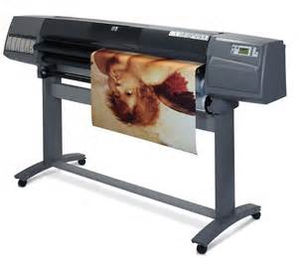
Planning Poster Content
Contact printer to find out print limitations
  Sometimes the conference guidelines allow a larger poster than you can print
Conference
Space
Provided
Printer
Limitations

Slide 30
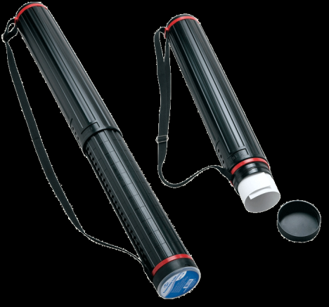
Planning Poster Content
Conference may give you a large board, but you don’t have to use it all
  E.g. 4x8 ft. is huge
Huge posters difficult to travel with
  Harder to hang too
You will probably be blocking half of your poster

Slide 31
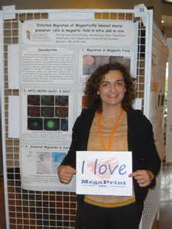
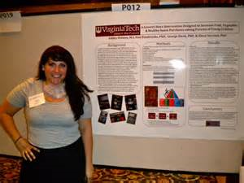
Planning Poster Content
Blocked poster
Unblocked poster

Slide 32
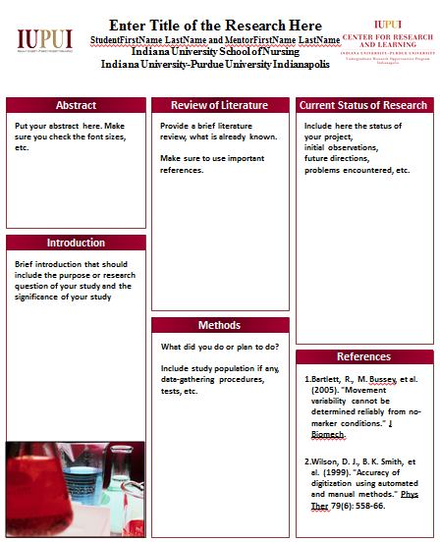
Planning Poster Content
Start with a PowerPoint template (or make your own)
http://www.crl.iupui.edu/resources/poster-design.asp

Slide 33

Planning Poster Content
Determine take home message
  If someone were to describe your poster in one sentence, what would that sentence be?
  E.g. “S/he studied mouse models for Down syndrome and found that their skulls are smaller and underdeveloped.”
Poster presentation should reinforce this theme

Slide 34

Planning Poster Content
Create sections of text in Word
  Title, abstract, introduction, materials and methods, results, conclusions, references
Create images, tables
  High quality to avoid blurry images when blown up

Slide 35
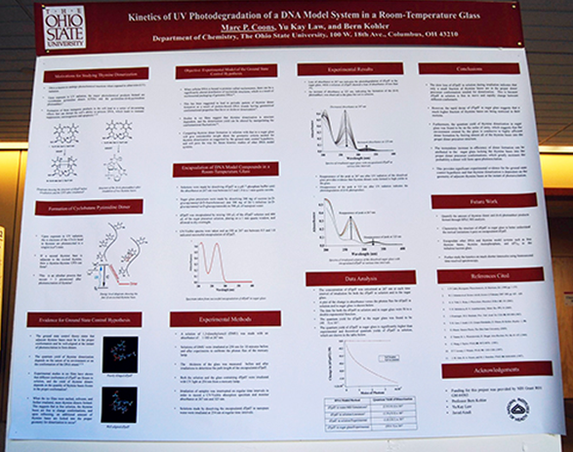
Planning Poster Content
Use negative or empty space to make poster readable, resist cramming too much text
  Use borders or empty space to group sections and images

Slide 36
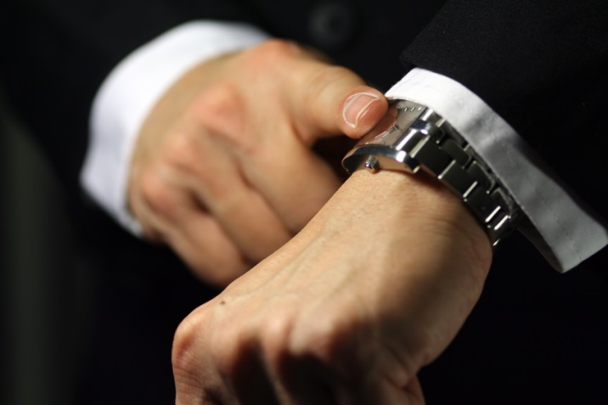
Planning Poster Content
Avg. viewer will spend 3-6 minutes looking and 1-3 minutes asking questions
  Some people will read abstract and/or conclusion only

Slide 37
Design and Layout
Fonts
  Large enough to read from 3-4 ft. away
    Can you read me now?
    Can you read me now?
    Can you read me now?
  Easy to read
    What does this say?
    What does this say?
    What does this say?
  Check with your printer, some fonts not allowed
    E.g. Helvetica fonts do not work on IUSD printer

Slide 38
Design and Layout
Headings and other text with same importance should be the same font size
Font size varies based on poster dimensions
Suggested starting font sizes:
  Title: 100-144 pt.
  Authors: 56 pt.
  Sub-headings: 72-84 pt.
  Text body: 18-24 pt.
  Captions: 14-16 pt.
  Acknowledgements and References: 10-16 pts.

Slide 39
Design and Layout
  Title: 100 pt.
  Authors: 56 pt.
  Sub-headings: 72 pt.
  Text body: 24 pt.
  Captions: 16 pt.
This gives you an idea of the ratio of font sizes
to each other
When you adjust one you usually have to adjust
others

Slide 40
Design and Layout
Avoid excessive text
  Rough guidelines: 20% text, 40% figures, 40% space
    Varies by discipline and project
Leave space around text so poster flows
Keep font types and sizes consistent for similar sections
  E.g. all captions same size and font

Slide 41
Design and Layout
Avoid odd colored text that doesn’t show well
  Title
  Authors
  Sub-headings
  Text body
  Captions
If you must use, add background
  Title
  Authors

Slide 42
Design and Layout
Do not use all upper case letters
  AUDIENCE MAY THINK YOU ARE YELLING AT THEM!!!
Use bold or italics to emphasize words or phrases
  Posters let you talk to people rather than at them
Left-align text
  Fully-justified text creates large gaps between words
    Harder to read

Slide 43
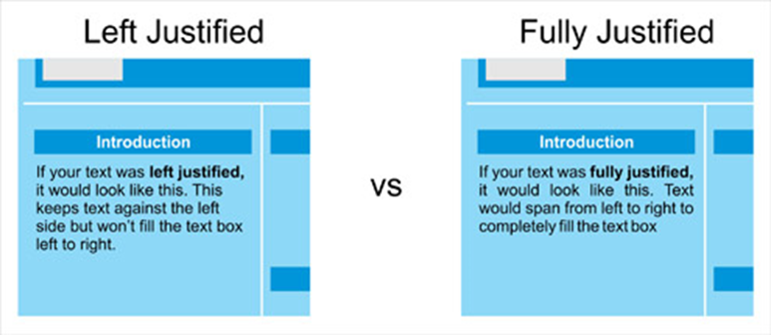
Large spaces
between words

Slide 44
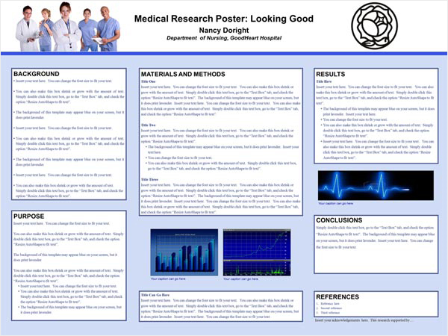
Writing Poster Content
Use 2-3 colors for poster theme
  Figures, graphs can be exception
  Too many colors looks chaotic, unprofessional

Slide 45
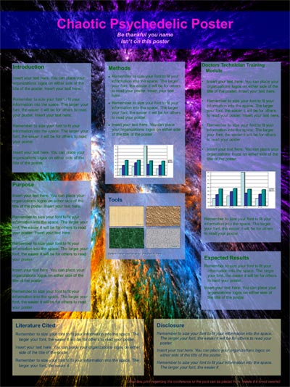
Writing Poster Content
Recommended: Use dark text and light background
Busy background can be distracting

Slide 46

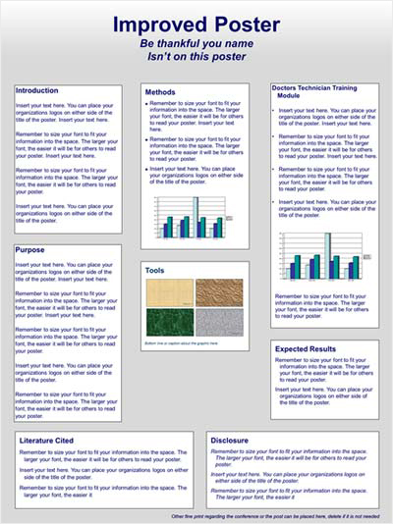
How can we improve this poster?
Better?
Get rid of noisy background
Change color scheme

Slide 47
Writing Poster Content
Print preview copy before final print
  Confirm poster looks good, no mistakes
    Very easy for mistakes to appear as you edit poster
Triple check dimensions before printing

Slide 48
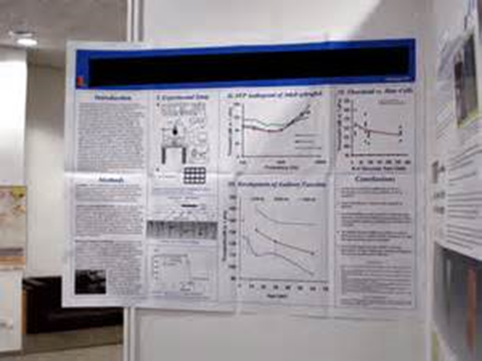
What is wrong with this poster?
Incorrect poster dimensions…
Causes human traffic issues
Poster crowding problems for other presenters
Looks bad

Slide 49

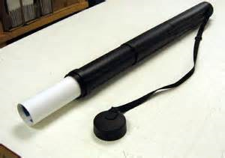
Also, this poster has been folded
Unless you print on cloth, it is not ok to fold your poster.
  Use a poster tube, do not let it get wet.

Slide 50
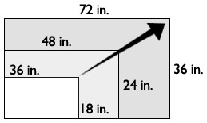
Poster Size
When modifying your poster, make sure aspect ratio is intact
  In ppt. Format tab → Size button → Lock Aspect Ratio

Slide 51

Poster Size
If aspect ratio is incorrect, you get stretched images and text
Important
text
that people
want
to read

Slide 52
Poster Content
Less is more
  Brief background and summary
Poster should open dialogue with viewer
  Going overboard with unnecessary details will chase viewers away

Slide 53
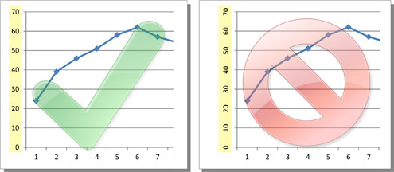
Poster Content
Avoid vertically aligned labels
  Horizontal labels easier to read
Viewer shouldn’t have to turn head sideways to read

Slide 54
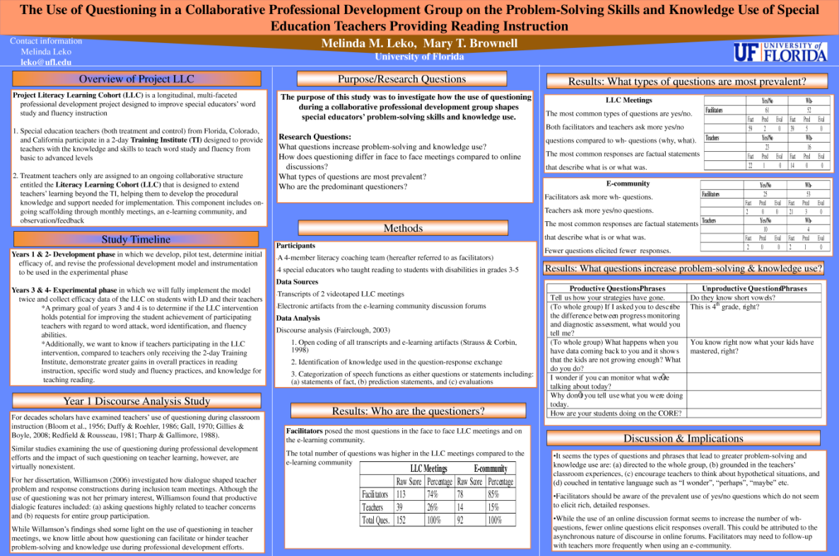
How might we criticize this poster?
Title difficult to read from distance
Too much text…
Section headers
not consistent
No figures
Overall, poster isn't very visually appealing

Slide 55
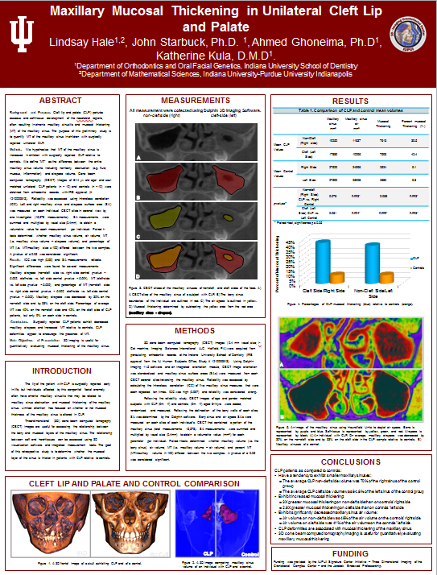
Obviously, this poster is perfect
b/c it has my name on it
Text is spaced out
Headers are consistent
Title can be read from a
distance
Images attractive and
interesting
Bulleted conclusions for easy
read

Slide 56
Benefits of Poster over Oral Presentation
Posters allow you to create strong visual components that may be more appropriate for your topic/discipline
  Depending on format, may not be possible with oral presentation
Posters allow one-to-one interaction and feedback, longer conversations
  You talk to people rather than at them

Slide 57
References
http://www.crl.iupui.edu/resources/poster-design.asp
http://www.makesigns.com/tutorials/

Slide 58
Questions?

